Slide 1

DEFENCE SERVICES ACADEMY
M.Sc (21th Batch) Computer Science
DEPARTMENT OF COMPUTER SCIENCE
Pyin Oo Lwin
Notes:
Good Afternoon! Honorable and invited guests, all of my Lecturers, supervisor and my batch friends.

Slide 2
IMPLEMENTATION OF AN AUTOMATED DYNAMIC WEAPON RANGE VISUALIZATION AND ENGAGAEMENT PLANNING FOR MILITARY TACTICAL SUPPORT SYSTEM USING GEOSPATIAL DATA
Presented by
Captain Aung Nyi Nyi Min
M.Sc (21th Batch)
Supervisor Lt.Col Zar Nay Lin
Co-supervisor Major Zin Min Thu
2
Notes:
Firstly, May I introduce myself.
I'm Captain Aung Nyi Nyi min, and Master Candidate at Department of Computer Science.
Today I' would like to present my thesis work.
The title of my thesis is “IMPLEMENTATION OF AN AUTOMATED DYNAMIC WEAPON RANGE VISUALIZATION AND ENGAGAEMENT PLANNING FOR MILITARY TACTICAL SUPPORT SYSTEM USING GEOSPATIAL DATA” .
And my supervisor is Lt.Col Zar Nay Lin, and Co-supervisor is Major Zin Min Thu.

Slide 3
Outlines
Abstract
Introduction
Aim of Thesis
Objectives of Thesis
Problem Statement
Background Theories
Conclusion
3
Notes:
OK! First of all, I would like to present outlines of my thesis.
In this seminar, I will present our thesis as these program. And generally divided by 7 state.
First stage is the abstract of our thesis.
Second stage is the Introduction of our thesis.
Third stage is the Aim of our thesis.
Fourth stage is the Objectives of our thesis.
Fifth is the Problem Statement .
Sixth is the Scope of thesis and background theory.
Finally, is the conclusion of our thesis.

Slide 4
Abstract
The system automates the process of mapping current and target locations, measuring distances, and visualizing weapon ranges based on their power and specifications.
The system integrates various APIs to retrieve real-time geolocation data and converts geographic coordinates to the Military Grid Reference System (MGRS) for accurate positioning.
The system calculates the distance from the current location to the desired target, visualizes the effective firing ranges on interactive maps, and identifies the optimal troops and weapons for engagement based on proximity and ammunition requirements.
4
Notes:
In this slides, May I present about the abstract of my thesis.

Slide 5
Introduction
In the realm of modern warfare, the precision and efficiency of tactical operations are paramount to mission success.
Traditional methods of planning and executing tactical operations are often time-consuming and prone to human error, necessitating the development of automated systems that can enhance decision-making processes.
The system supports the ability to quickly and accurately determine the positioning of forces, calculate engagement ranges, and optimize resource allocation can significantly impact the outcome of military engagements.
5
Notes:
Now I would like to present the introduction of system.

Slide 6
Aim of my thesis
The primary aim of this thesis is to develop an automated system that supports military tactical planning by dynamically visualizing weapon firing ranges and optimizing engagement strategies using real-time geospatial data. This system is designed to improve the efficiency and accuracy of military operations, ultimately contributing to mission success.
6
Notes:
Now I would like to present the Aim of my thesis

Slide 7
Objectives
To integrate APIs for retrieving real-time geolocation data
To implement algorithms that accurately measure distances between current and target locations
To develop a visualization module based on weapon specifications.
To create algorithms that identify optimal troops and weapons
To design an intuitive user interface
To conduct extensive testing with simulated and real-world data to ensure the system's accuracy, reliability, and practical utility.
7
Notes:
And then I would like to present the objectives of our thesis.

Slide 8
Problem Statement
In modern military, effective tactical planning and resource allocation are critical for mission success and minimizing collateral damage.
The current methods of tactical planning are time-consuming, prone to human error, and lack the agility required for real-time decision-making.
This thesis aims to develop an Automated TDSS that integrates real-time geospatial data, advanced algorithms, and intuitive visualizations to enhance tactical planning.
8
Notes:
And then I would like to present the problem statement of system.

Slide 9
Background Theory
Flutter
Web API
Hyper Text Transfer Protocol (HTTP)
Personal Home Page or Hypertext Preprocessor (PHP)
Relational Database Management System (RDBMS)
MySQL Database Server
GIS
Tactical Decision Support System (TDSS)
Military Grid Reference System (MGRS)
Algorithm for LatLng to MGRS Conversion
9
Notes:
In this slide, I would like to present the background thoery of system.

Slide 10
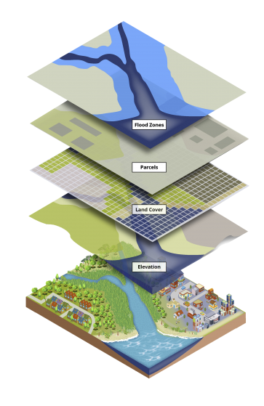
Geospatial Information Systems (GIS)
Geospatial Information Systems (GIS) represent a pivotal technology in the realm of spatial data management and analysis. GIS integrates hardware, software, and data for capturing, managing, analyzing, and displaying all forms of geographically referenced information. This technology has become indispensable across various disciplines, including urban planning, environmental management, logistics, epidemiology, natural resource management, and of course, military operations.
10

Slide 11
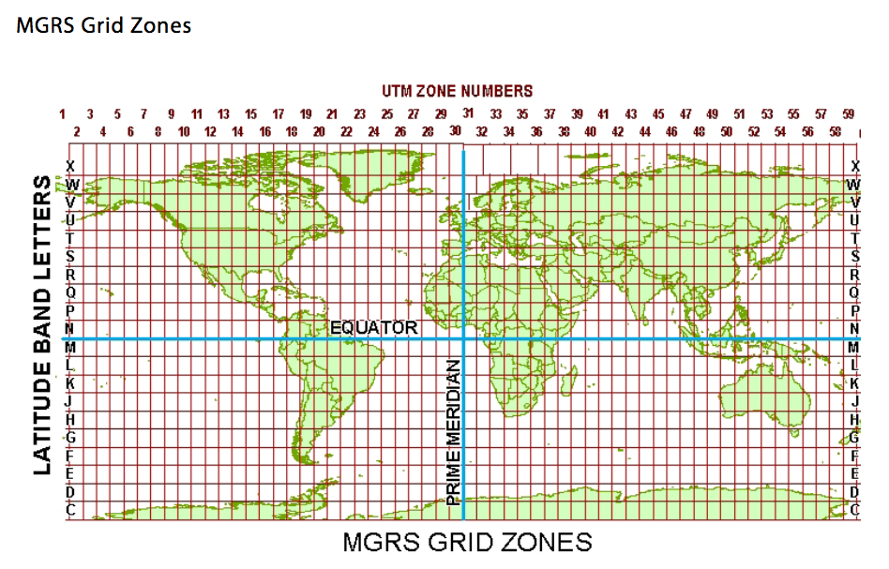
Military Grid Reference System (MGRS)
The Military Grid Reference System (MGRS) is a geographic coordinate system used extensively by military forces worldwide for locating points on the Earth's surface. It is based on the Universal Transverse Mercator (UTM) coordinate system but provides a more concise and standardized method of representing geographic coordinates. MGRS divides the Earth's surface into a grid of zones, each identified by a unique combination of zone number, zone letter, grid square identifier, and numerical location identifier.
11

Slide 12
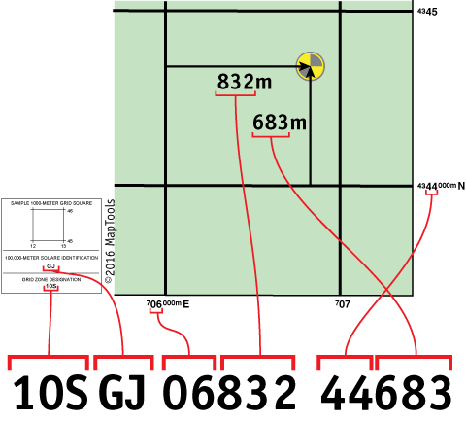
LatLng to MGRS Conversion
The conversion from LatLng (latitude, longitude) to MGRS involves several steps, including:
Convert LatLng to UTM (Universal Transverse Mercator) coordinates
Determine the UTM zone
Convert UTM to MGRS
12

Slide 13
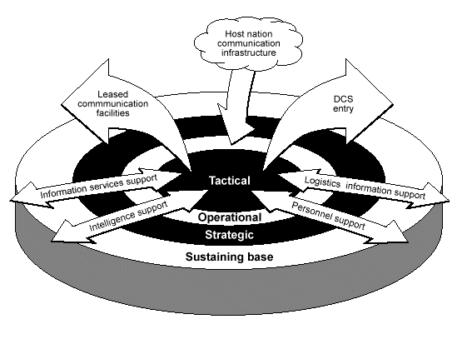
Tactical Decision Support System (TDSS)
A Tactical Decision Support System (TDSS) is a specialized software application designed to assist military commanders and decision-makers in making informed decisions during tactical operations. It integrates various data sources, analytical tools, and visualization techniques to provide real-time situational awareness and actionable insights.
13

Slide 14
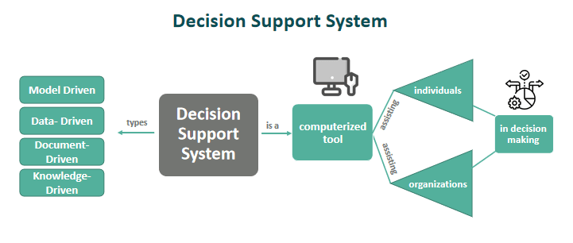
General Equations and Algorithms Used in TDSS
Distance Calculation
Route Planning
Weapon Firing Solutions
Spatial Analysis
14

Slide 15
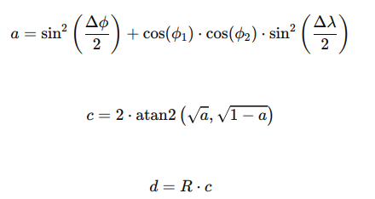
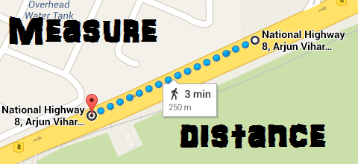
General Equations and Algorithms Used in TDSS
Distance Calculation: Here use Haversine Formula to calculate distance.
Where:
ϕ1​,ϕ2​: Latitudes of the two points
Δϕ, Δλ: Differences in latitude and longitude between the points
R: Radius of the Earth (mean radius = 6,371 km)
d is the distance between the two points along the surface of the sphere.
15

Slide 16
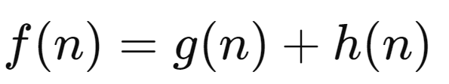
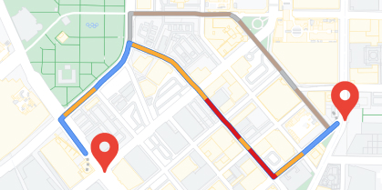
General Equations and Algorithms Used in TDSS
Route Planning : Here use A Algorithm (A-star) to calculate Route Planning.
Where:
f(n): Estimated total cost of path through node n
g(n): Cost to reach node n
h(n): Estimated cost from n to the goal based on heuristic
16

Slide 17
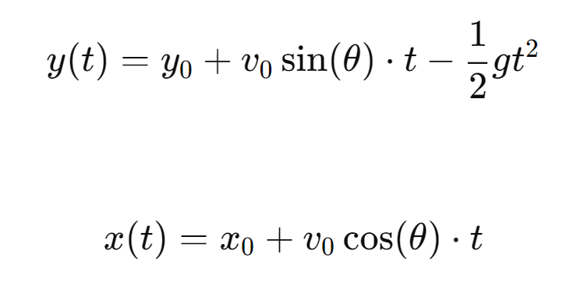
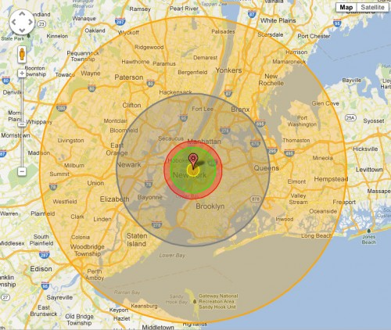
General Equations and Algorithms Used in TDSS
Weapon Firing Solutions : Here use Ballistic Equations to calculate Weapon Firing Solutions.
Where:
(x₀​,y₀​): Initial coordinates of the projectile
v₀​: Initial velocity of the projectile
θ: Launch angle
g: Acceleration due to gravity
17

Slide 18
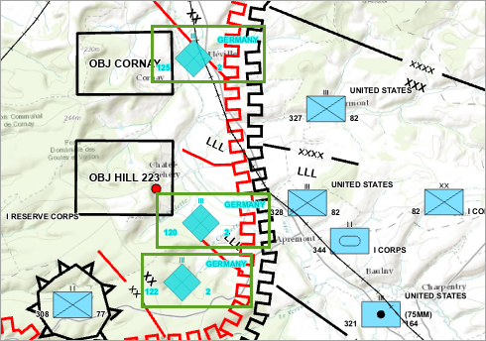
General Equations and Algorithms Used in TDSS
Spatial Analysis :
Overlay Operations: Used to analyze spatial relationships between different layers or datasets on a map. Operations include intersection, union, difference, and buffering to determine areas of overlap, containment, or proximity between spatial features.
18

Slide 19


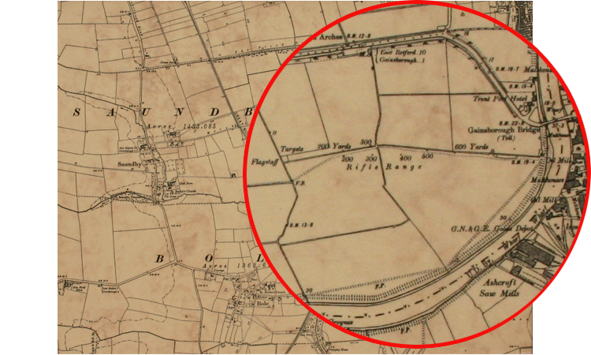


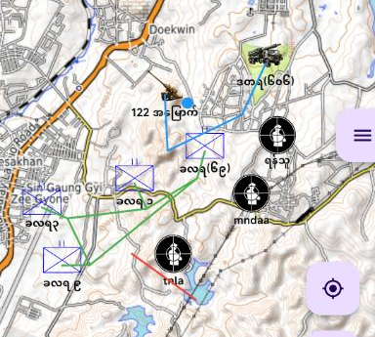

Proposed System Design
Transfer)
Weapon Range Specification
Real-Time Location Data
Geospatial Data
Dynamic Visualization Engine(Real-Time Map On Android or IOS)
Engagement Planning & TDSS Interface
Real-time Data Processing
Feedbacks & Adjustment Loop
19

Slide 20
Conclusion
This system supports an Automated Military Tactical Support System, designed to leverage advancements in Geospatial Information Systems (GIS) and algorithmic optimization to provide dynamic visualizations of weapon firing ranges and comprehensive engagement planning.
It also supports to automate the process of retrieving location data, measuring distances, visualizing weapon ranges, and calculating optimal engagement strategies, thereby providing military personnel with a robust tool for more precise and effective decision-making.
20

Slide 21
Any Suggestions?

Slide 22
Thank You

Slide 23
“ The Telegraph to Cyber Text in Telegraphing of Upper Department and Subordinates using Advanced Encryption Standard (AES) Model ”
“Monitoring Crop Health and Automated Pest Detection in Precision Agriculture Using U-Net 64 ”
23
Notes:
စိုက်ပျိုးရေးတွင် အရာဝတ္တု ထောက်လှမ်းခြင်း အသုံးချခြင်း- သီးနှံကျန်းမာရေးကို စောင့်ကြည့်ခြင်းနှင့် အလိုအလျောက် ပိုးမွှားရှာဖွေခြင်း

